Slide 1
Fashion Trends and Tips
A Style Guide

Slide 2
Understanding Body Types
First, let's discuss the importance of understanding different body types and how to dress for them. This will help you choose outfits that flatter your unique shape.

Slide 3
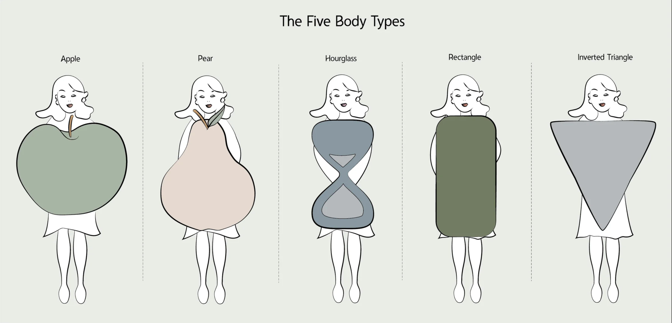
Apple, Pear, and Hourglass
The three most common body types are apple (wider waist), pear ( narrower shoulders than hips), and hourglass (curvy with a defined waist). Dressing for your type enhances your favorite features.

Slide 4
Creating a Capsule Wardrobe
A capsule wardrobe is a collection of essential, versatile items that can be mixed and matched to create multiple outfits. It's an efficient and sustainable way to build a functional wardrobe.

Slide 5
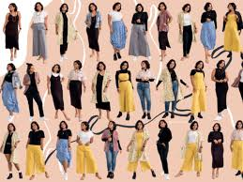
Capsule Wardrobe Example
By investing in timeless, high-quality pieces, you can create a stylish and sustainable wardrobe.

Slide 6
Color Coordination
Color plays a significant role in fashion. Understanding color theory and how to coordinate colors will help you create stylish and harmonious outfits.

Slide 7
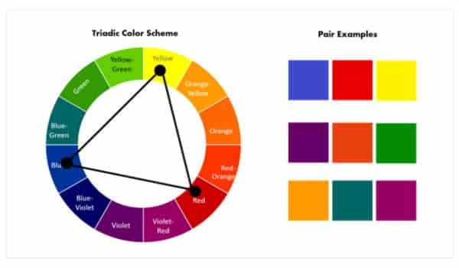
Color Wheel Harmony
Using the color wheel, you can create outfits with complementary colors (opposites) or analogous colors (neighbors) for a stylish effect.

Slide 8
Accessorizing Like a Pro
Accessories can make or break an outfit. Learn how to choose and style accessories like scarves, belts, and jewelry to elevate your look.

Slide 9
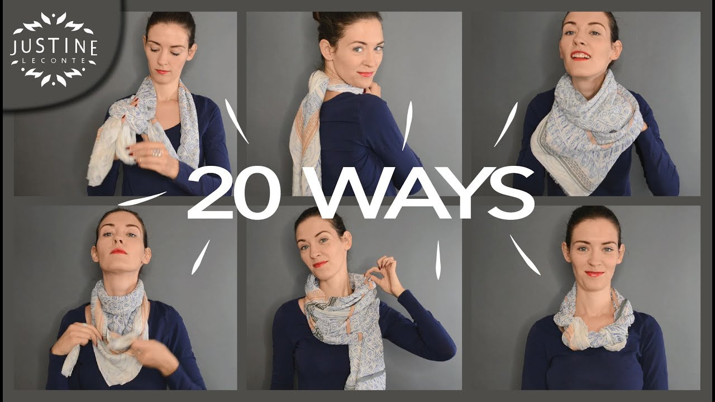
Accessorizing Tips
Scarves are a versatile accessory. Try different folding and tying techniques to create a variety of looks.

Slide 10
Fashion Do's and Don'ts
A few simple do's and don'ts to keep in mind when putting together outfits. These tips will help you avoid common fashion pitfalls.

Slide 11
Thank You!

